Slide 1
SQL: DML (Part 2)
SCSD2523 Database
Semester 1 2019/2020

Slide 2
Learning Objective
At the end of the topic, students will be able to construct SQL statements for data manipulations with multiple tables
Subqueries
Simple Join
Equijoin:
NATURAL JOIN;
JOIN … ON;
INNER JOIN ON
Outer join:
LEFT OUTER JOIN;
RIGHT OUTER JOIN;
FULL OUTER JOIN

Slide 3
Subqueries
Nested query
Contains outer & inner SELECT statements.
The result of inner SELECT (subquery) is used by the outer query to determine the final output.
Subqueries written at:
WHERE or HAVING clause
SELECT or FROM clause
When subquery written at SELECT clause, the subquery output is a single value.

Slide 4
Subqueries
Example 1:
List employee id and salary of all employees who are working in the sales department.
SELECT employee_id, salary
FROM employees
WHERE department_id =
( SELECT department_id
FROM departments
WHERE department_name = “Sales” )

Slide 5
Subqueries
What if we want to also display the department name in the result? How should the statement be written?
Will this query execute correctly???
SELECT employee_id, salary, department_name
FROM employees
WHERE department_id =
( SELECT department_id
FROM departments
WHERE department_name = “Sales” )

Slide 6
Obtaining Data From Multiple Tables
Sometimes you need to use and display data from more than one table.
Employee IDs exist in the EMPLOYEES table.
Department IDs exist in both the EMPLOYEES and DEPARTMENTS tables.
Department names exist in the DEPARTMENTS table.
To produce the report, you need to join the EMPLOYEES and DEPARTMENTS tables, and access data from both of them.

Slide 7
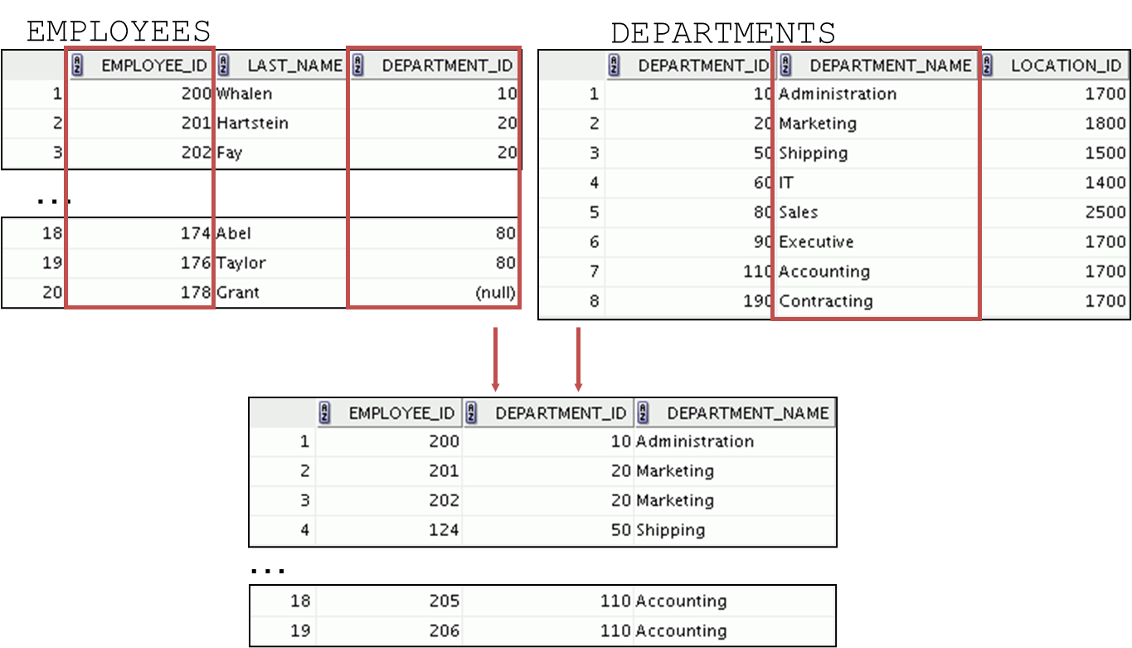
Obtaining Data From Multiple Tables

Slide 8
Simple Join / Traditional Method
Query 1:
List the employee first name, last name and employee salary for the SALES department.
SELECT first_name, last_name, salary
FROM employees, departments
WHERE employees.department_id = departments.department_id
AND departments.department_name = ‘Sales’;
This is a simple join
*without the use of any special syntax in SQL

Slide 9
Simple Join / Traditional Method
Query 2:
List all employees id, first name, last name and department name.
SELECT employee_id, first_name, last_name, department_name
FROM employees, departments
WHERE employees.department_id = departments.department_id;

Slide 10
Simple Join / Traditional Method
Query 3:
List all employee id, first name, last name, department id and department name.
SELECT employee_id, first_name, last_name, department_name, department_id
FROM employees, departments
WHERE employees.department_id = departments.department_id;
Why error occur?
How to correct the error?

Slide 11
Simple Join / Traditional Method
Query 3:
List all employee id, first name, last name, department id and department name.
SELECT employee_id, first_name, last_name, department_name, employee.department_id
FROM employees, departments
WHERE employees.department_id = departments.department_id;
To solve the ambiguous column
issue, use Table prefix to correct the error

Slide 12
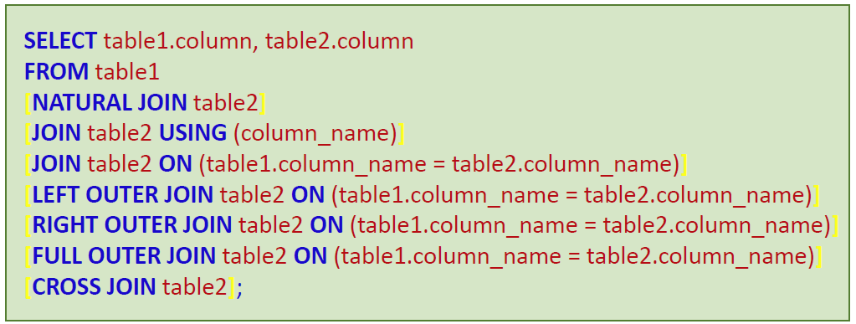
Joining Tables Using SQL:1999 syntax
Use a join to query data from more than one table:
[ ] = optional

Slide 13
Equijoins
That is where a column (or multiple columns) in two or more tables match
Can write using:
Simple join:
SELECT…FROM…WHERE
ANSI syntax:
NATURAL JOIN
JOIN…USING
JOIN…ON
INNER JOIN…ON

Slide 14
Using NATURAL JOIN
The NATURAL JOIN clause is based on all columns in the two tables that have the same name.
It selects rows from the two tables that have equal values in all matched columns.
If the columns having the same names have different data types, an error is returned.

Slide 15
Using NATURAL JOIN
Query 2:
List all employees id, first name, last name and department name.
SELECT employee_id, first_name, last_name, department_name
FROM employees
NATURAL JOIN departments;

Slide 16
Using NATURAL JOIN
Query 3:
List all employee id, first name, last name, department id and department name.
SELECT employee_id, first_name, last_name, department_name, department_id
FROM employees
NATURAL JOIN departments;

Slide 17
Using NATURAL JOIN
Query 4:
List all employee id, first name, last name, department name and department location id.
SELECT employee_id, first_name, last_name, department_name, location_id
FROM employees
NATURAL JOIN departments;

Slide 18
Using NATURAL JOIN
Query 4b:
List all employee id, first name, last name, department name and city.
SELECT employee_id, first_name, last_name, department_name, city
FROM employees
NATURAL JOIN departments
NATURAL JOIN locations;
Natural join with multiple tables

Slide 19
Using JOIN…USING clause
If several columns have the same names but the data types do not match, use the USING clause to specify the columns for the equijoin.
Use the USING clause to match only one column when more than one column matches.

Slide 20
Using JOIN…USING clause
Query 3:
List all employee id, first name, last name, department id and department name.
SELECT employee_id, first_name, last_name, department_id, department_name
FROM employees
JOIN departments
USING (department_id);
Join based on the department_id attribute

Slide 21
Using JOIN…ON clause
The JOIN condition for the NATURAL JOIN is basically an equijoin of all columns with the same name.
Use the ON clause to specify arbitrary conditions or specify columns to join.
The join condition is separated from other search conditions.
The ON clause makes code easy to understand.

Slide 22
Using JOIN…ON clause
Query 3:
List all employee id, first name, last name, department id and department name.
SELECT employee_id, first_name, last_name, department_id, department_name
FROM employees
JOIN departments
ON (employees.department_id = departments.department_id);

Slide 23
Using JOIN…ON clause
Query 4:
List all employee id, first name, last name, department name and department location id.
SELECT employee_id, first_name, last_name, department_name, location_id
FROM employees
JOIN departments
ON (employees.department_id = departments.department_id);

Slide 24
Using JOIN…ON clause
Query 4b:
List all employee id, first name, last name, department name and city.
SELECT employee_id, first_name, last_name, department_name, city
FROM employees e
JOIN departments d
ON e.department_id = d.department_id
JOIN locations l
ON d.location_id = l.location_id;
Using JOIN…ON with multiple tables

Slide 25
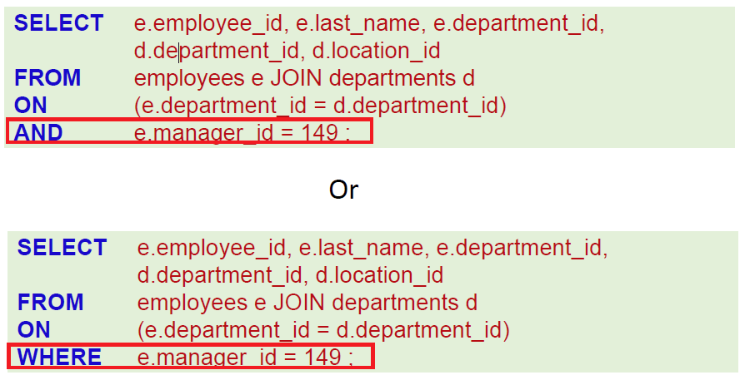
Applying Additional Conditions to a Join
Use the AND clause or the WHERE clause to apply additional conditions:

Slide 26
Self Join
A self join is a special form of equijoin or INNER JOIN where a table is joined against itself.
This means that the table must exists two times in the FROM clause of the SQL query.
Note that when joining a table to itself an alias must be used for each of the tables in the FROM clause and then also used in the select list and WHERE clause

Slide 27
Self join using INNER JOIN…ON
Query 5:
List all employee id, first name, last name and their manager’s id and first name, last name.
SELECT e.employee_id, e.first_name, e.last_name, m.employee_id MANAGER_ID, m.first_name MANAGER_FNAME, m.last_name MANAGER_LNAME
FROM employees e
INNER JOIN employees m
ON e.manager_id = m.employee_id;

Slide 28
Self join using INNER JOIN…ON
Query 5:
List all employee id, first name, last name and their manager’s id and first name, last name.
SELECT e.employee_id, e.first_name, e.last_name, m.employee_id MANAGER_ID, m.first_name MANAGER_FNAME, m.last_name MANAGER_LNAME
FROM employees e
JOIN employees m
ON e.manager_id = m.employee_id;
JOIN and INNER JOIN are functionally equivalent

Slide 29
Self join using INNER JOIN…ON
Query 6:
List all employee who are the manager.
SELECT DISTINCT e.manager_id, m.first_name, m.last_name
FROM employees e
INNER JOIN employees m
ON e.manager_id = m.employee_id;

Slide 30
Using INNER JOIN…ON
Query 3:
List all employee id, first name, last name, department id and department name.
SELECT employee_id, first_name, last_name, department_id, department_name
FROM employees
INNER JOIN departments
ON (employees.department_id = departments.department_id);

Slide 31
Using INNER JOIN…ON
Query 4:
List all employee id, first name, last name, department name and department location id.
SELECT employee_id, first_name, last_name, department_name, location_id
FROM employees
INNER JOIN departments
ON (employees.department_id = departments.department_id);

Slide 32
OUTER JOIN
Often times we need to return rows from one table even if there are no matching rows that are produced through a join condition. For this situation, we use outer joins.
Outer joins:
LEFT OUTER JOIN
RIGHT OUTER JOIN
FULL OUTER JOIN

Slide 33
LEFT OUTER JOIN
A left outer join is where the table, on the left of a FROM clause is required to return all of its rows regardless of having matching rows from the table it is being joined on.

Slide 34
Using LEFT OUTER JOIN
Query 7:
List all department with all its employees, including all department without employee.
SELECT department_name, first_name
FROM departments
LEFT OUTER JOIN employees
ON (departments.department_id = employees.department_id);

Slide 35
RIGHT OUTER JOIN
A right outer join is just the opposite of a left outer join. It states that you would like all rows from the right table in the FROM clause to be returned regardless of having a true match defined in the WHERE clause against the left side table in the FROM clause.

Slide 36
Using RIGHT OUTER JOIN
Query 8:
List all employees with their departments, including all employees without department.
SELECT department_name, first_name
FROM departments
RIGHT OUTER JOIN employees
ON (departments.department_id = employees.department_id);

Slide 37
FULL OUTER JOIN
Return both left and right sides of a query regardless of having a match.

Slide 38
Using FULL OUTER JOIN
How can we get the records for all employees AND all departments whether they are missing data or not?
SELECT department_name, first_name
FROM departments
FULL OUTER JOIN employees
ON (departments.department_id = employees.department_id);

